Slide 1
Goodman ONE
Assembly Guide

Slide 2
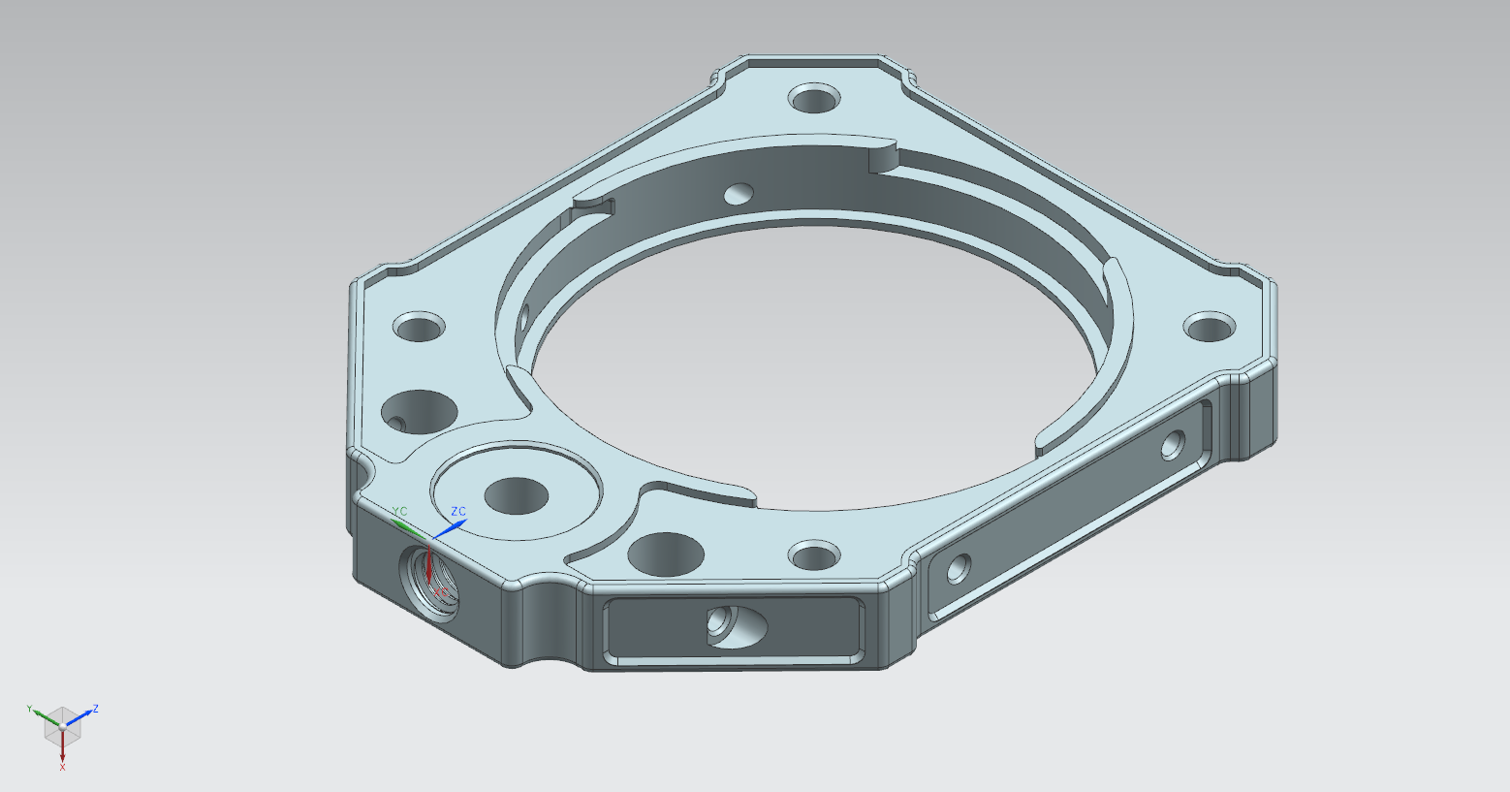
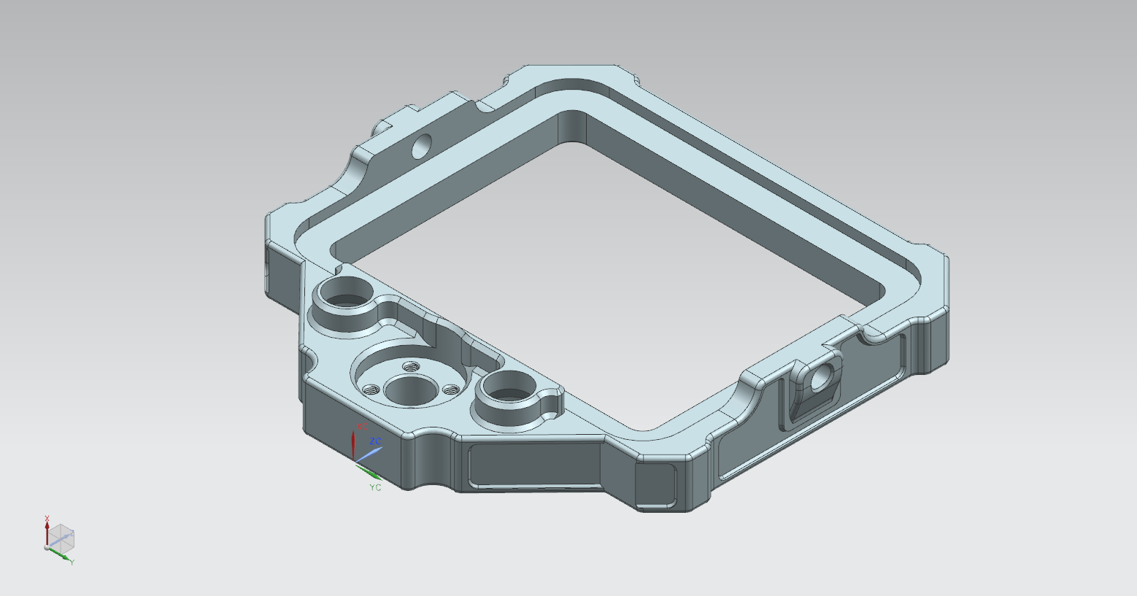
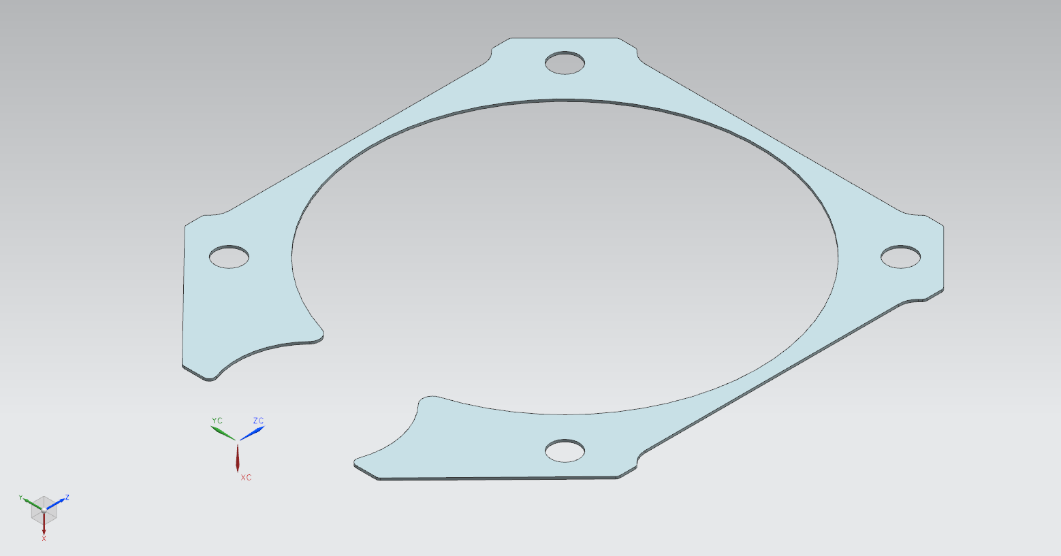
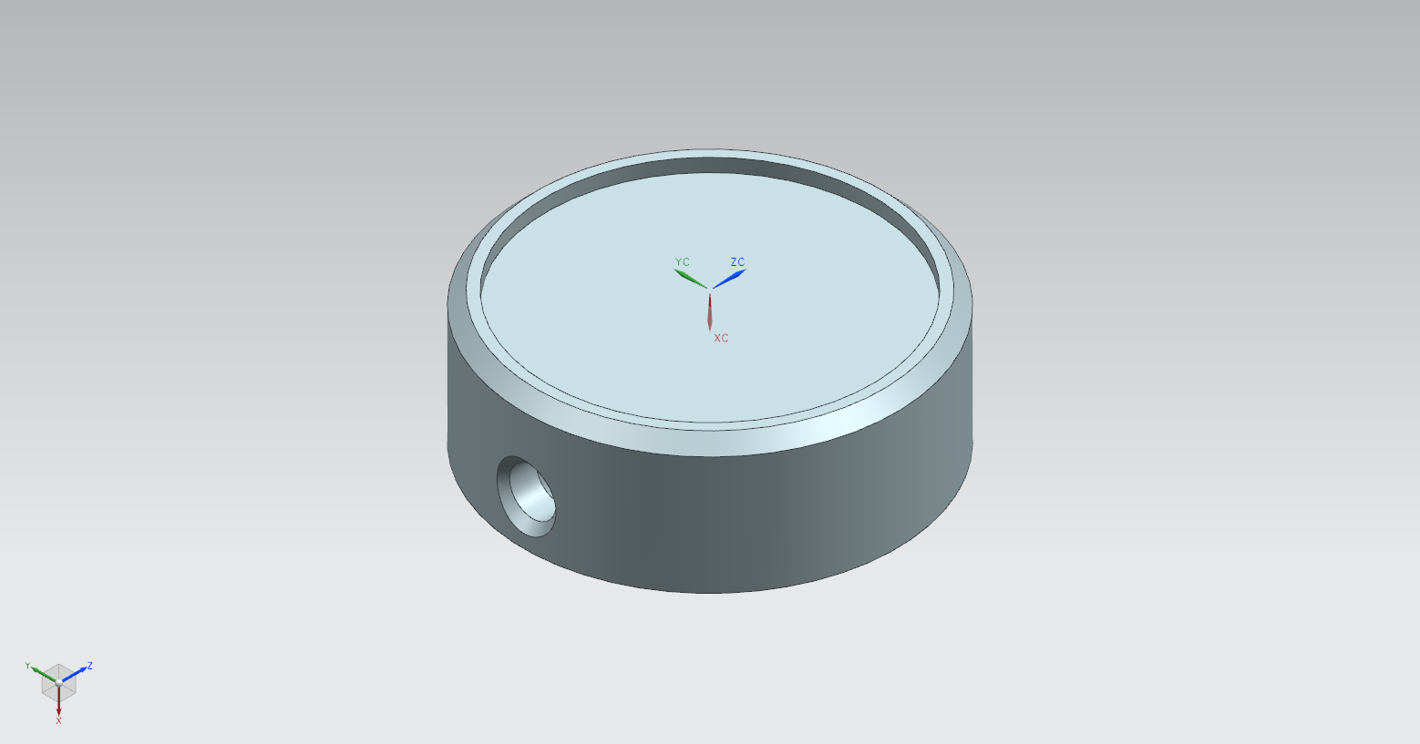
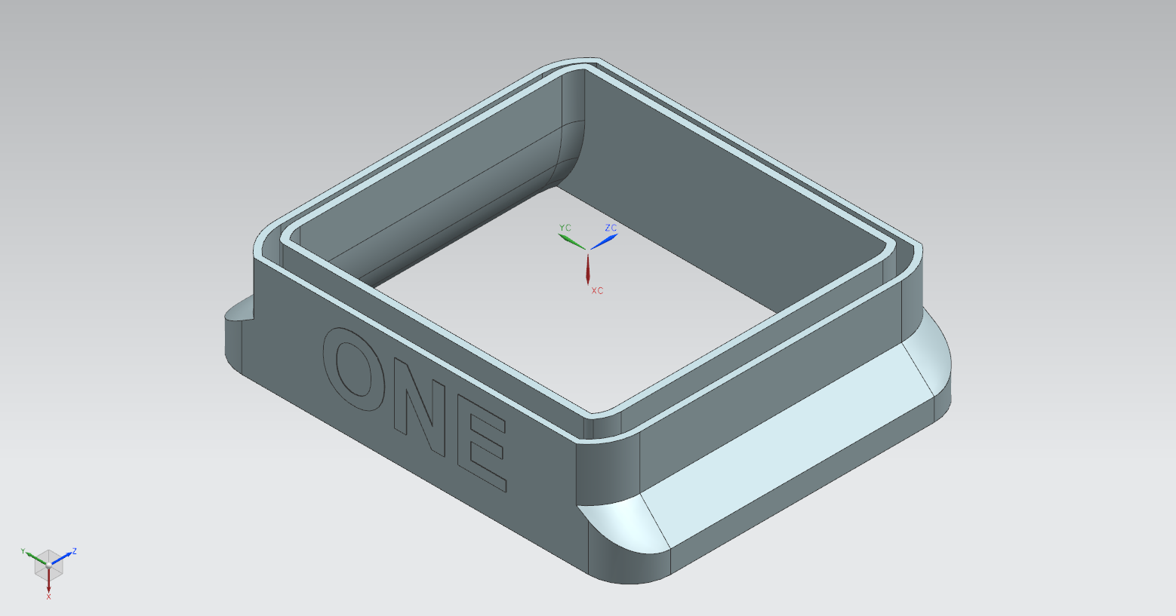
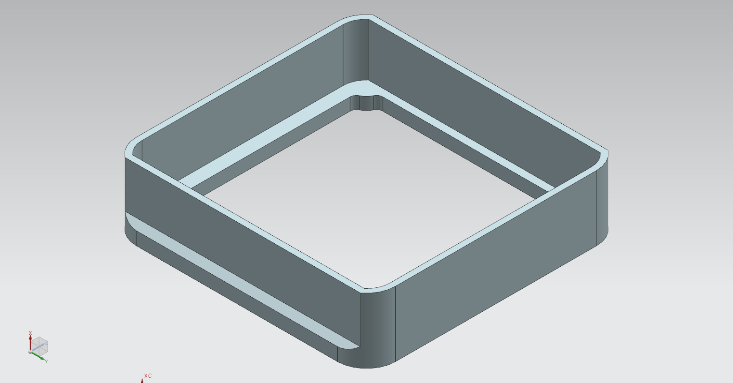
PRINTED PARTS
Camera Body
Front Plate Rear Plate Front Cover
Focusing Knob Bellows Female Bellows Male

Slide 3
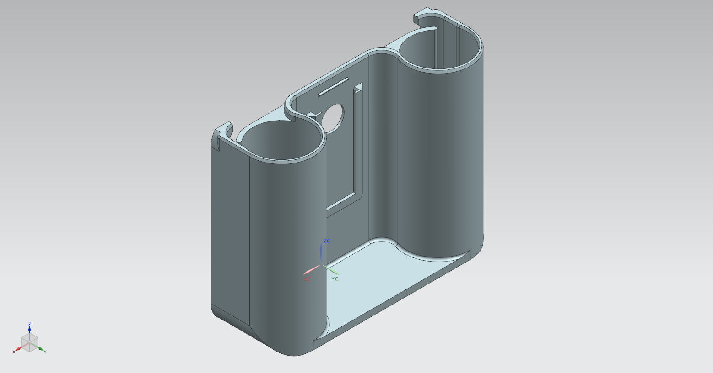
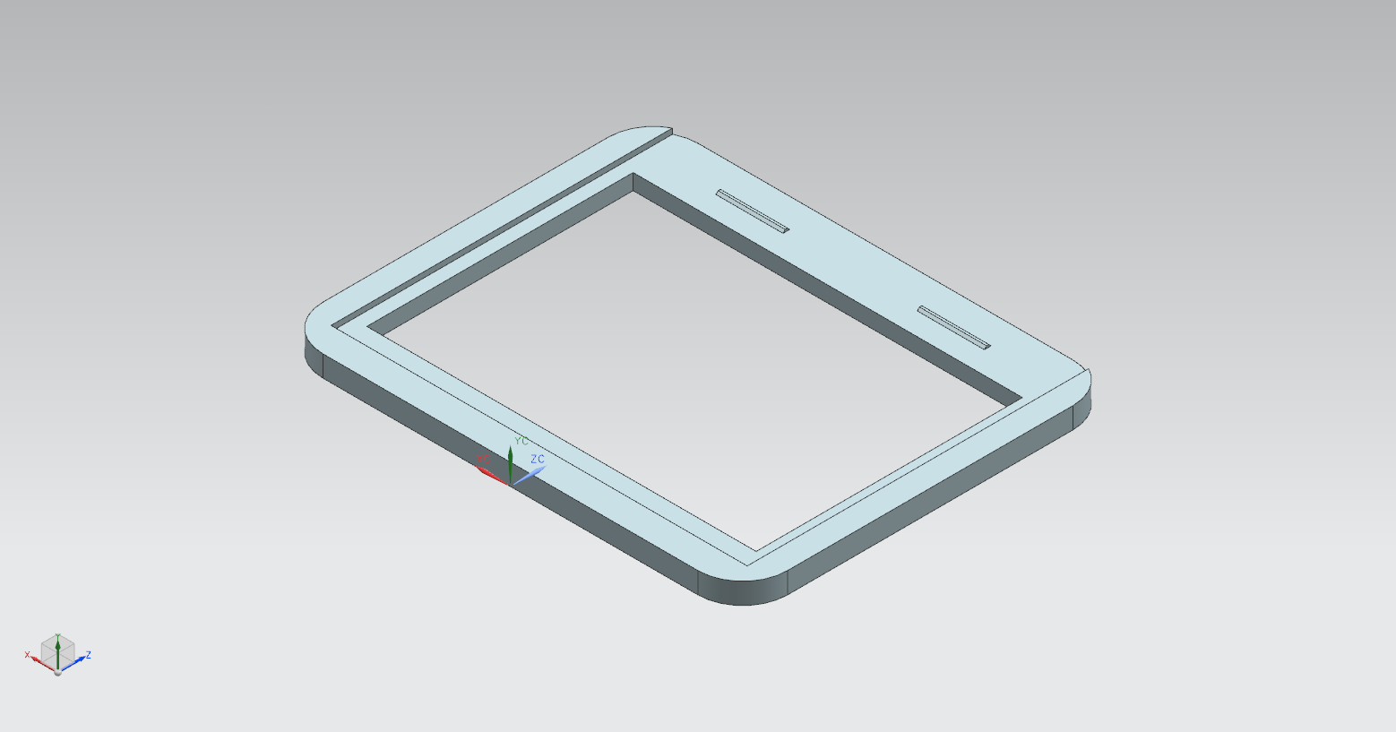
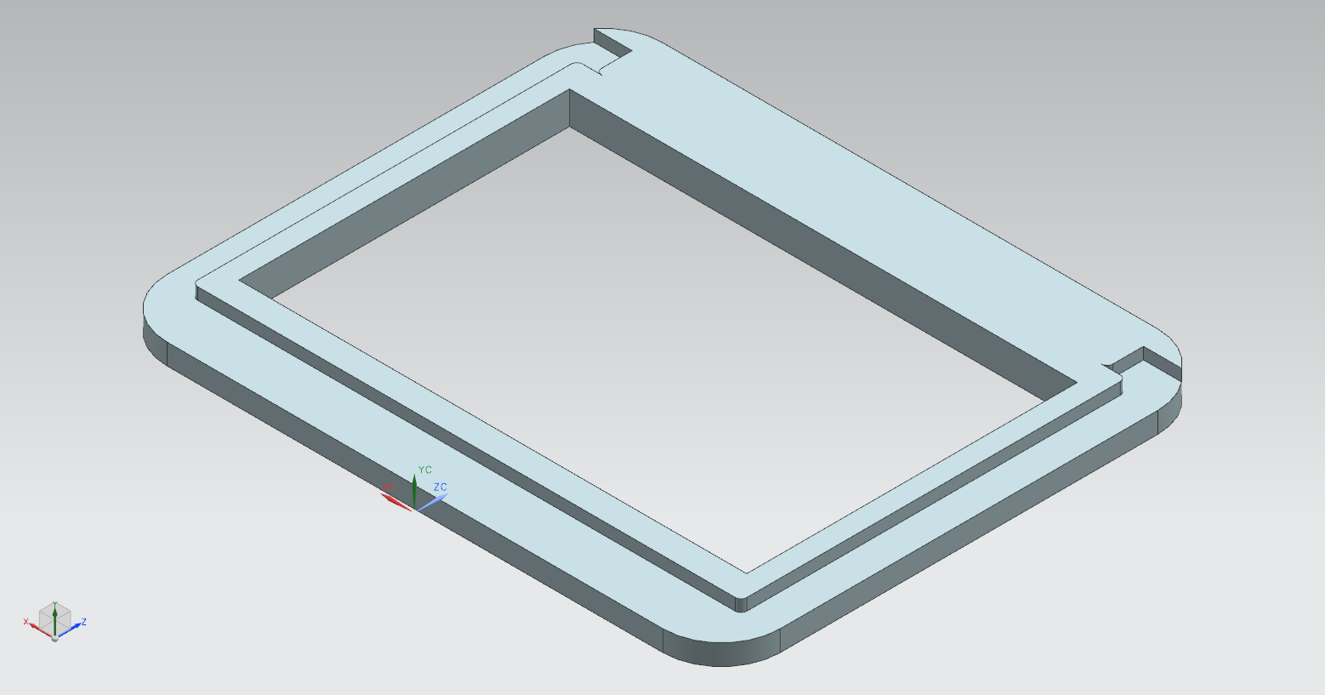
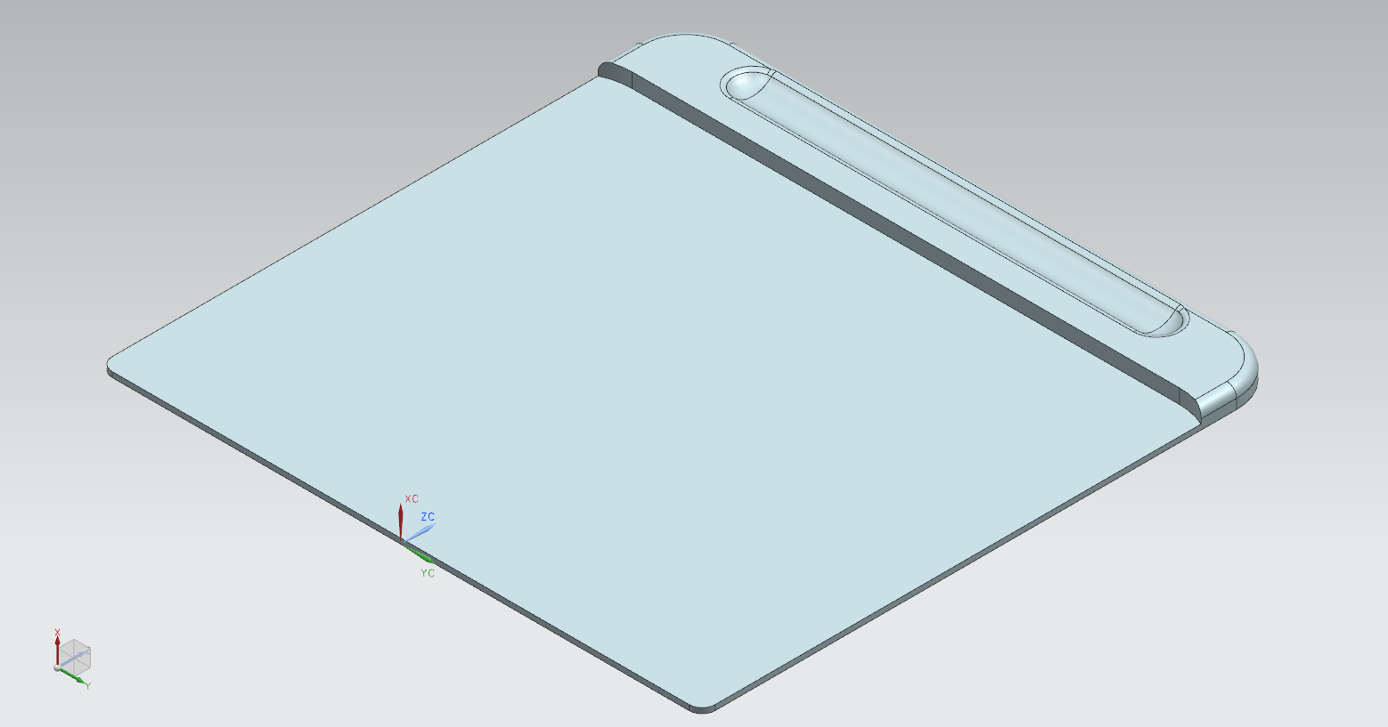
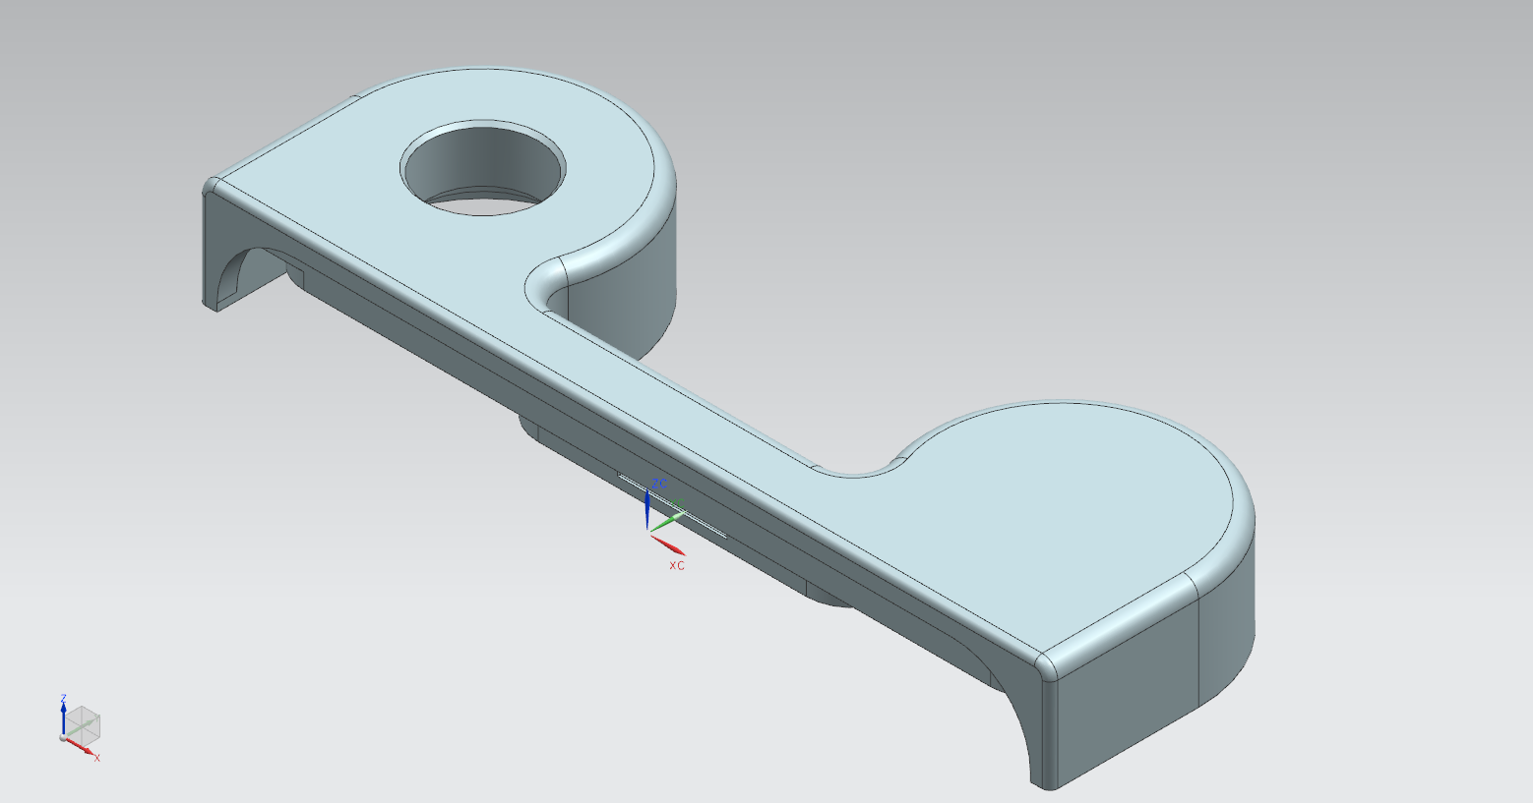
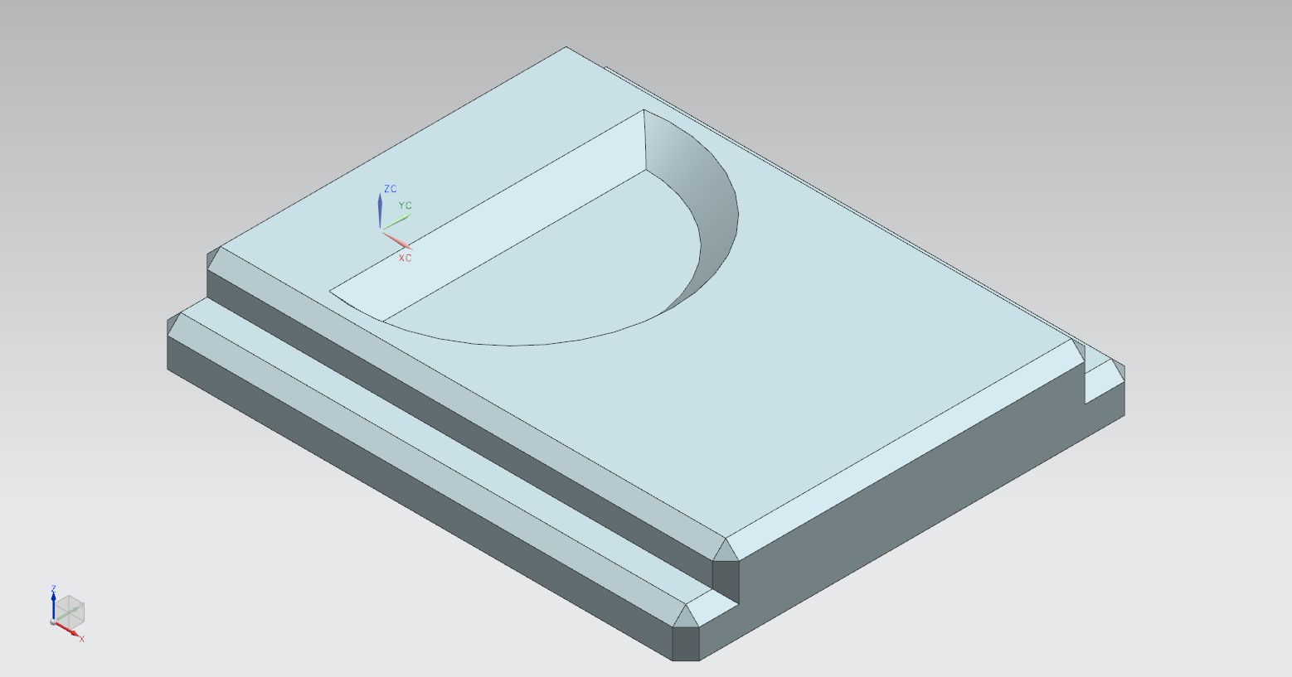
PRINTED PARTS
6x9 Film Back
Magazine Body Magazine Front Plate 1 Magazine Front Plate 2
Magazine Darkslide Magazine Lid Magazine Knob

Slide 4
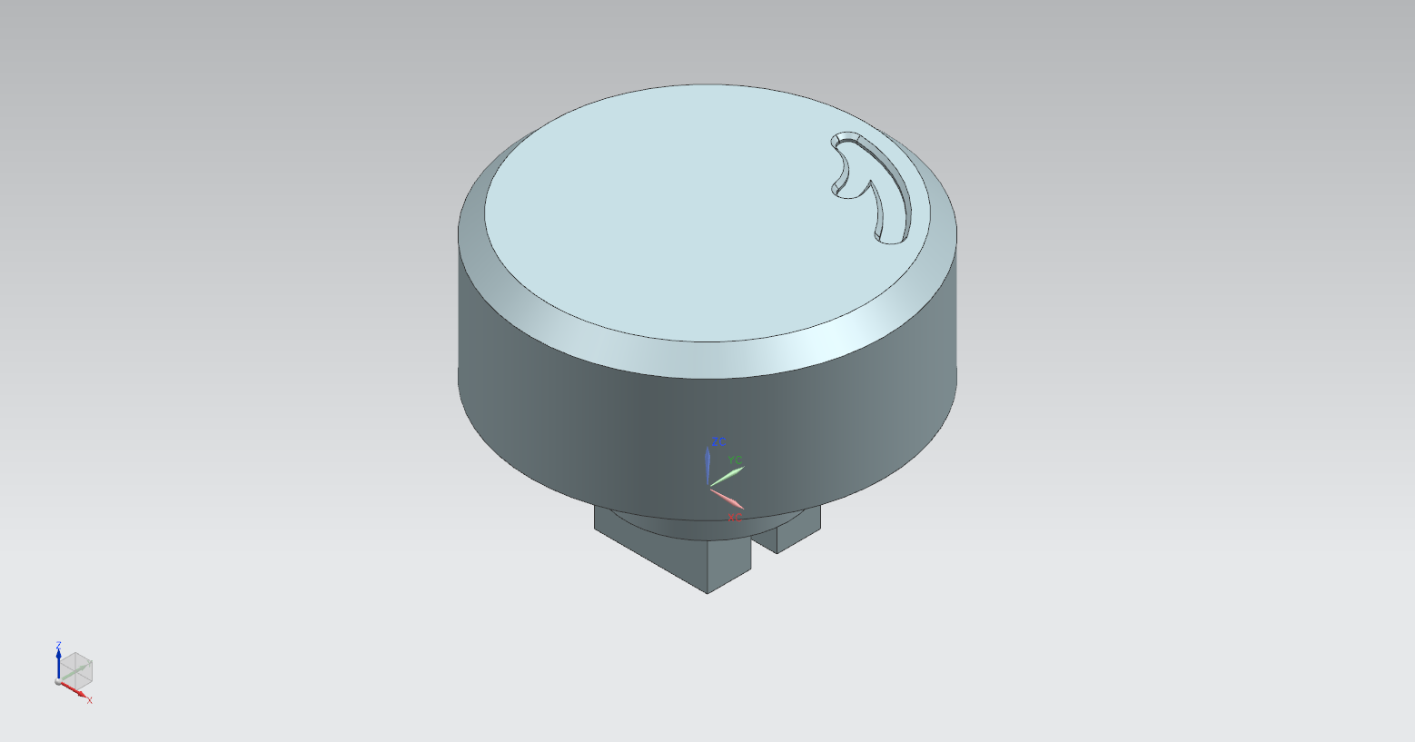
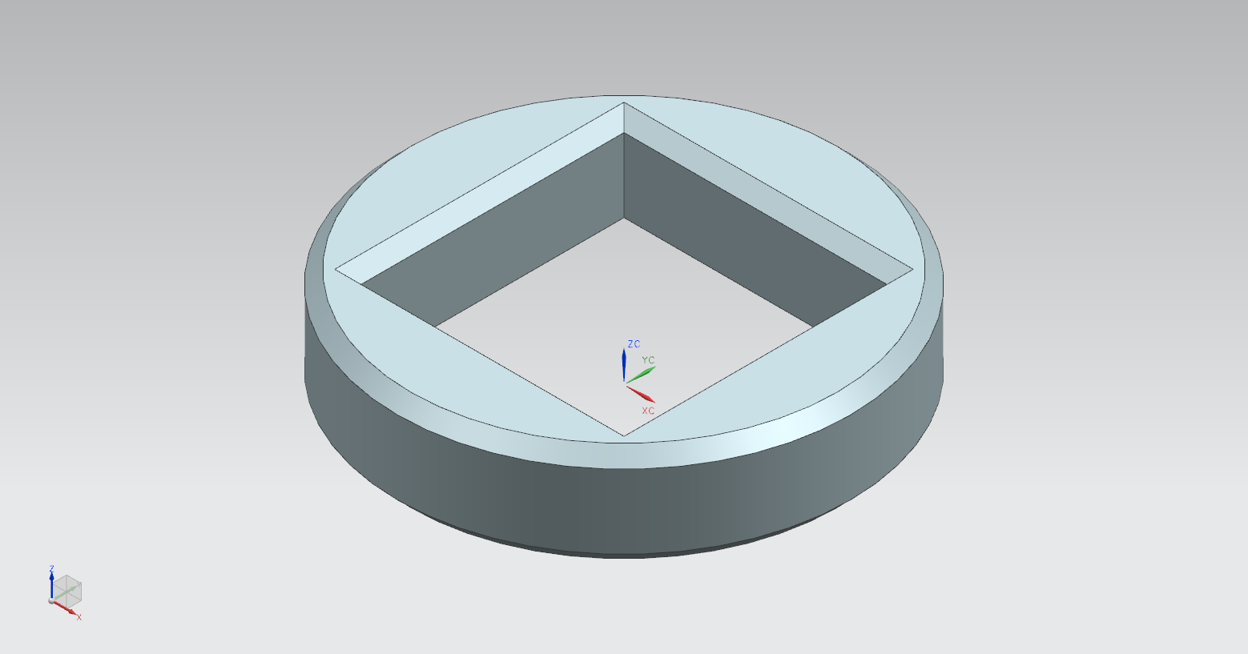
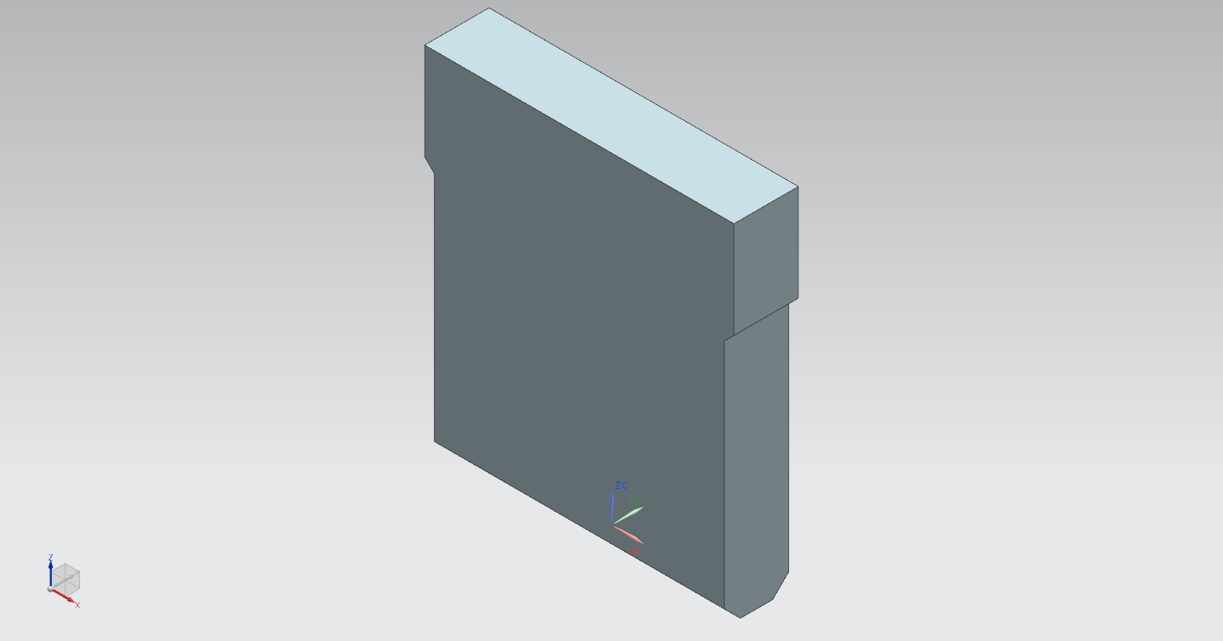
PRINTED PARTS
6x9 Film Back (Contd.)
Magazine Knob Magazine Knob Closer Magazine Winder Plate

Slide 5
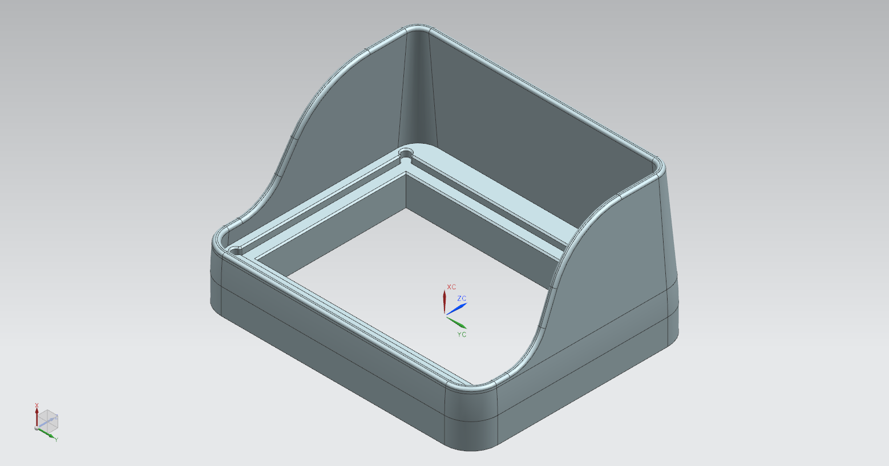
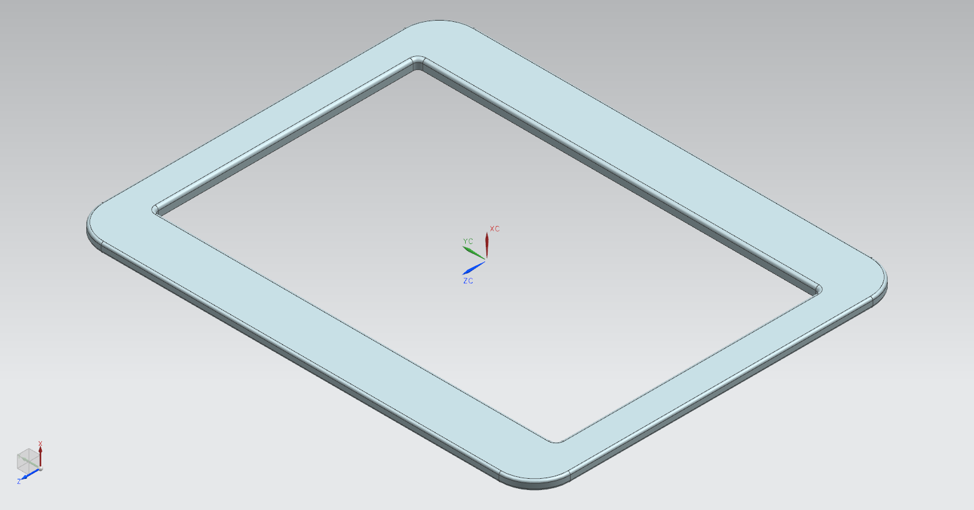
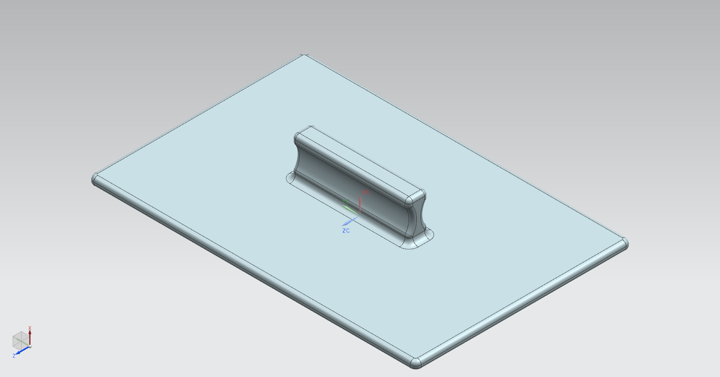
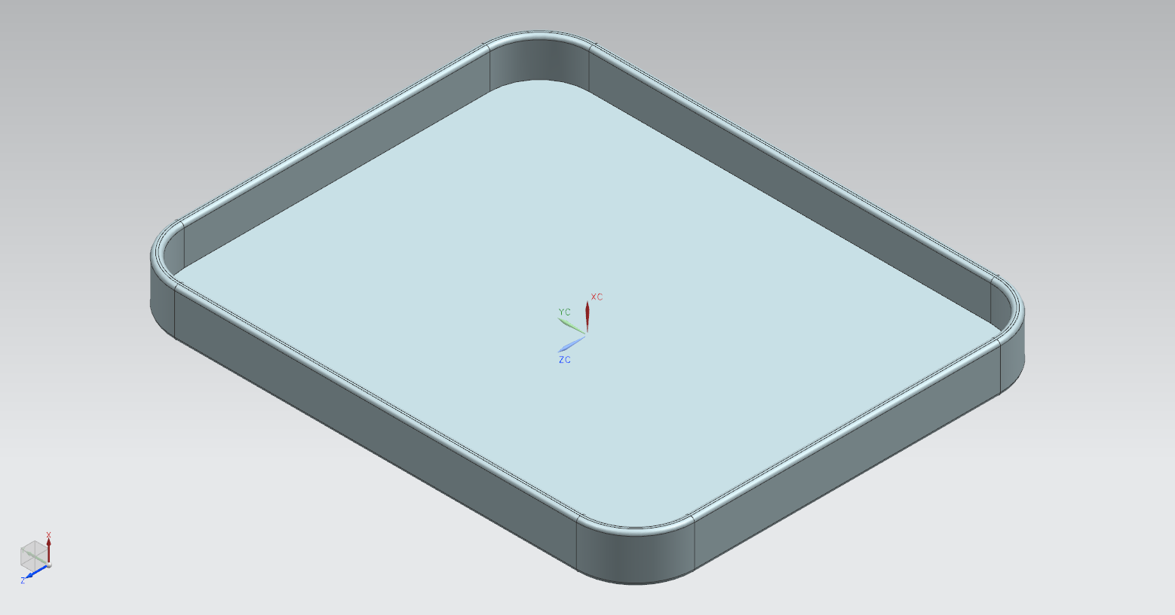
PRINTED PARTS
6x9 Focusing Screen
Holder, Ground Glass Retainer, Ground Glass Cover, Front, Ground Glass
Cover, Rear, Ground Glass

Slide 6
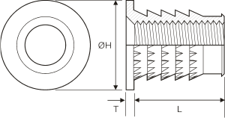
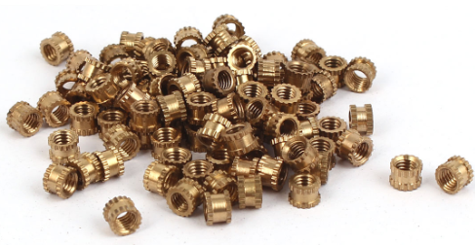
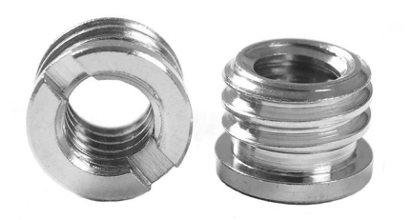
Other Hardware
Flanged Threaded Insert, Brass, M4
6 Pieces
Threaded Insert, Brass, M3
10 Pieces
Flanged Threaded Insert, Steel, 1/4”
1 Piece

